Slide 1


CONSTRUCTING THE REAL NUMBERS FROM THE NATURAL NUMBERS
Samuel Spencer
James Bowling
MAT-470-10426-M01
December 9, 2024

Slide 2
OVERVIEW
1
CONSTRUCTING THE INTEGERS
CONSTRUCTING THE RATIONAL NUMBERS
Use equivalence relation to construct the Integers from the Natural Numbers
Use equivalence relation to construct the Rational Numbers from the Integers
4
2
EMERGENCE OF IRRATIONAL NUMBERS
CONSTRUCTING THE REAL NUMBERS
Observe how the Irrational numbers emerge as a consequence of the construction of the Reals
Use Dedekind cuts to construct the Real Numbers from the Rational Numbers
3

Slide 3
DISCLAIMER!

Slide 4





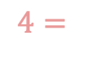






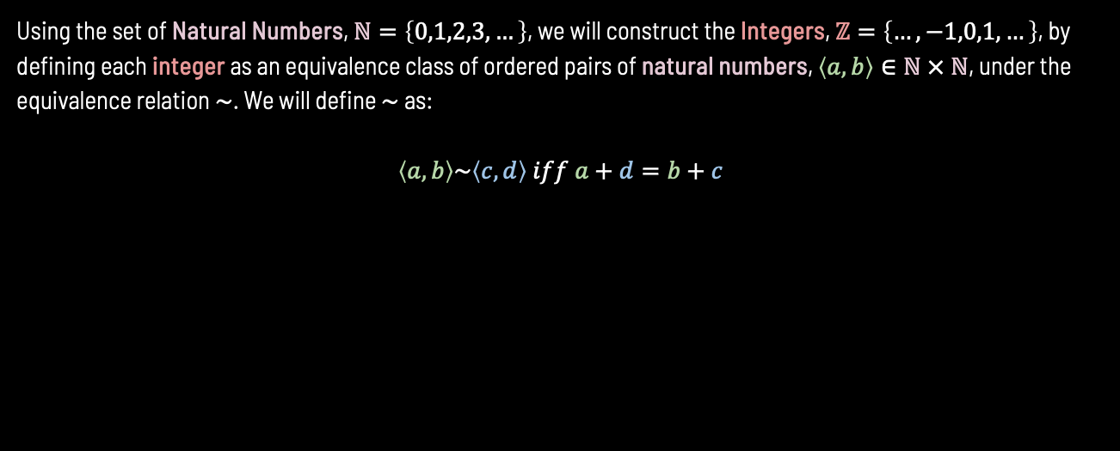








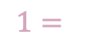





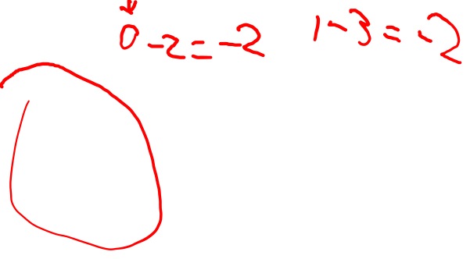

CONSTRUCTING THE INTEGERS
Using the set of Natural Numbers, $ℕ=\left\{0,1,2,3,…\right\}$, we will construct the Integers, $ℤ=\left\{…,−1,0,1,…\right\}$, by defining each integer as an equivalence class of ordered pairs of natural numbers, $\left\langle a,b\right\rangle ∈ℕ × ℕ$, under the equivalence relation $\sim$. We will define $\sim$ as:
$$\left\langle a,b\right\rangle \sim \left\langle c,d\right\rangle iff a+d=b+c$$
$$(7−3)$$
($0−2)$
$$\left\langle 1,0\right\rangle$$
($4−0)$
$$−105=$$
($106−311)$
$$\left\langle 8,7\right\rangle$$
$$4=$$
$$(15−11)$$
$$\left\langle 5,1\right\rangle$$
($97−99)$
($0−105)$
$$1=$$
$$\left\langle 20,19\right\rangle$$
$$−2=$$
$$\left\langle 4,6\right\rangle$$
($1−3)$
$$\left\langle 188,187\right\rangle$$
$$(162−158)$$
($998−1,000)$
($999−1,004)$
…
($34−139)$
$$\left\langle 3,2\right\rangle$$
$$\left\langle 14,13\right\rangle$$
$$(5−1)$$
($13−15)$
Notes:
In plain English, if we take all ordered pairs of natural numbers that have the same difference (more literally where the first number is same amount bigger [or smaller] than the second number in the pair), then we can say all of those ordered pairs are equivalent to each other and can be grouped together. We can name each group (equivalence classes) of pairs based on their difference, so if we take the group where the first number is 2 smaller than the second number then we can name that group -2. From that we can take each name say each of those group names is how we define an integer, so the integer -2 represents that group.
In order to do this, we have to construct an equivalence relation that shows that each pair within each group can be seen as equivalent to each other. Doing so justifies them being grouped together. To make this relation, we can’t use subtraction since subtraction might give us a negative number which aren’t defined for the natural numbers, so we will take the first number in one pair and add it to the second number of another pair and if it is equal to the second number of the first pair added with the first number in the other pair then we can see that the both pairs have the same difference between each of their first and second numbers, which shows that in this way they are equivalent.

Slide 5














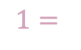







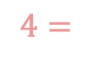




CORE IDEA
In plain English, if we take all ordered pairs of natural numbers that have the same difference (more literally where the first number is same amount bigger [or smaller] than the second number in the pair), then we can say all of those ordered pairs are equivalent to each other and can be grouped together. We can name each group (equivalence classes) of pairs based on their difference, so if we take the group where the first number is 2 smaller than the second number then we can name that group -2. From that we can take each name say each of those group names is how we define an integer, so the integer -2 represents that group.
$$(7−3)$$
($0−2)$
$$\left\langle 1,0\right\rangle$$
($4−0)$
$$−105=$$
($106−311)$
$$\left\langle 8,7\right\rangle$$
$$4=$$
$$(15−11)$$
$$\left\langle 5,1\right\rangle$$
($97−99)$
($0−105)$
$$1=$$
$$\left\langle 20,19\right\rangle$$
$$−2=$$
$$\left\langle 4,6\right\rangle$$
($1−3)$
$$\left\langle 188,187\right\rangle$$
$$(162−158)$$
($998−1,000)$
($999−1,004)$
…
($34−139)$
$$\left\langle 3,2\right\rangle$$
$$\left\langle 14,13\right\rangle$$
$$(5−1)$$
($13−15)$
In order to do this, we have to construct an equivalence relation that shows that each pair within each group can be seen as equivalent to each other. Doing so justifies them being grouped together. To make this relation, we can’t use subtraction since subtraction might give us a negative number which aren’t defined for the natural numbers, so we will take the first number in one pair and add it to the second number of another pair and if it is equal to the second number of the first pair added with the first number in the other pair then we can see that the both pairs have the same difference between each of their first and second numbers, which shows that in this way they are equivalent.

Slide 6
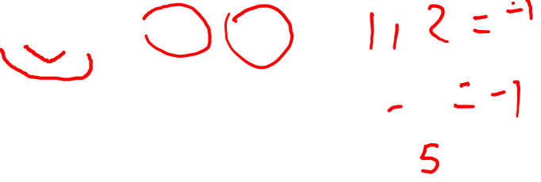
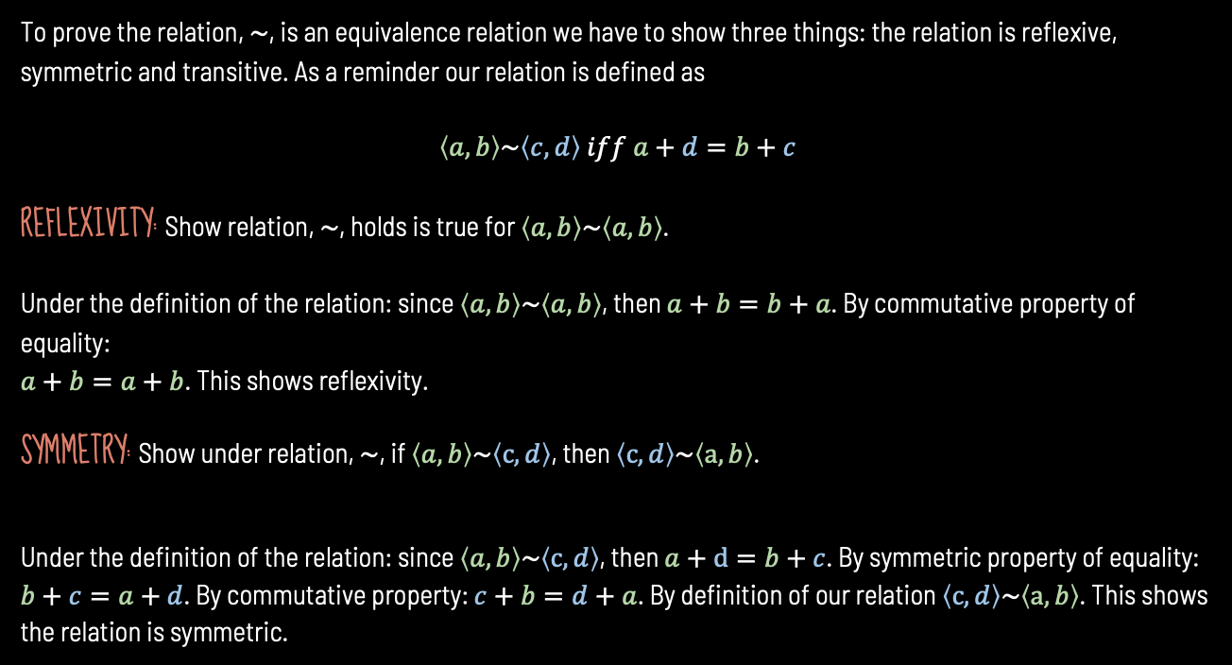
PROVING EQUIVALENCE RELATION.
To prove the relation, $\sim$, is an equivalence relation we have to show three things: the relation is reflexive, symmetric and transitive. As a reminder our relation is defined as
$$\left\langle a,b\right\rangle \sim \left\langle c,d\right\rangle iff a+d=b+c$$
REFLEXIVITY: Show relation, $\sim$, holds is true for $\left\langle a,b\right\rangle \sim \left\langle a,b\right\rangle$.
Under the definition of the relation: since $\left\langle a,b\right\rangle \sim \left\langle a,b\right\rangle$, then $a+b=b+a$. By commutative property of equality:
$a+b=a+b$. This shows reflexivity.
SYMMETRY: Show under relation, $\sim$, if $\left\langle a,b\right\rangle \sim \left\langle c,d\right\rangle$, then $\left\langle c,d\right\rangle \sim \left\langle a,b\right\rangle$.
Under the definition of the relation: since $\left\langle a,b\right\rangle \sim \left\langle c,d\right\rangle$, then $a+d=b+c$. By symmetric property of equality: $b+c=a+d$. By commutative property: $c+b=d+a$. By definition of our relation $\left\langle c,d\right\rangle \sim \left\langle a,b\right\rangle$. This shows the relation is symmetric.

Slide 7
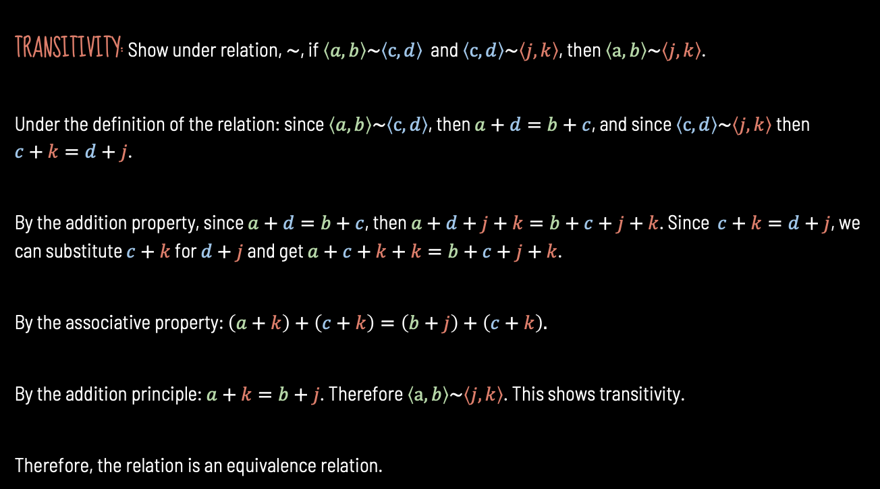
PROVING EQUIVALENCE RELATION CONTINUED
TRANSITIVITY: Show under relation, $\sim$, if $\left\langle a,b\right\rangle \sim \left\langle c,d\right\rangle$ and $\left\langle c,d\right\rangle \sim \left\langle j,k\right\rangle$, then $\left\langle a,b\right\rangle \sim \left\langle j,k\right\rangle$.
Under the definition of the relation: since $\left\langle a,b\right\rangle \sim \left\langle c,d\right\rangle$, then $a+d=b+c$, and since $\left\langle c,d\right\rangle \sim \left\langle j,k\right\rangle$ then $c+k=d+j$.
By the addition property, since $a+d=b+c$, then $a+d+j+k=b+c+j+k$. Since $c+k=d+j$, we can substitute $c+k$ for $d+j$ and get $a+c+k+k=b+c+j+k$.
By the associative property: $\left(a+k\right)+\left(c+k\right)=\left(b+j\right)+\left(c+k\right).$
By the addition principle: $a+k=b+j$. Therefore $\left\langle a,b\right\rangle \sim \left\langle j,k\right\rangle$. This shows transitivity.
Therefore, the relation is an equivalence relation.

Slide 8








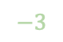


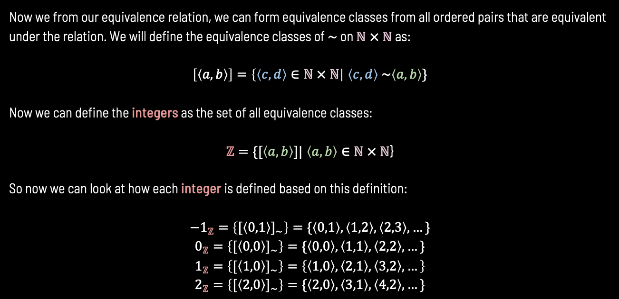

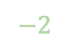








DEFINING THE INTEGERS.
Now we from our equivalence relation, we can form equivalence classes from all ordered pairs that are equivalent under the relation. We will define the equivalence classes of $\sim$ on $ℕ × ℕ$ as:
$\left[\left\langle a,b\right\rangle \right]=\left\{\left\langle c,d\right\rangle ∈ℕ × ℕ\right|$ $\left\langle c,d\right\rangle \sim \left\langle a,b\right\rangle \}$
Now we can define the integers as the set of all equivalence classes:
$ℤ=\{[\left\langle a,b\right\rangle ]|$ $\left\langle a,b\right\rangle ∈ℕ × ℕ$}
So now we can look at how each integer is defined based on this definition:
$$−1_{ℤ}=\left\{{[\left\langle 0,1\right\rangle ]}_{\sim }\right\}=\{\left\langle 0,1\right\rangle ,\left\langle 1,2\right\rangle ,\left\langle 2,3\right\rangle ,…\}$$
$$0_{ℤ}=\left\{{[\left\langle 0,0\right\rangle ]}_{\sim }\right\}=\{\left\langle 0,0\right\rangle ,\left\langle 1,1\right\rangle ,\left\langle 2,2\right\rangle ,…\}$$
$$1_{ℤ}=\left\{{[\left\langle 1,0\right\rangle ]}_{\sim }\right\}=\left\{\left\langle 1,0\right\rangle ,\left\langle 2,1\right\rangle ,\left\langle 3,2\right\rangle ,…\right\}$$
$$2_{ℤ}=\left\{{[\left\langle 2,0\right\rangle ]}_{\sim }\right\}=\{\left\langle 2,0\right\rangle ,\left\langle 3,1\right\rangle ,\left\langle 4,2\right\rangle ,…\}$$
$$a$$
$$5$$
$$4$$
$$3$$
$$2$$
$$1$$
$$0$$
$$5$$
$$−1$$
$$4$$
$$−2$$
$$3$$
$$−3$$
$$2$$
$$−4$$
$$1$$
$$−5$$
$$b$$
$$1$$
$$2$$
$$3$$
$$4$$
$$5$$

Slide 9
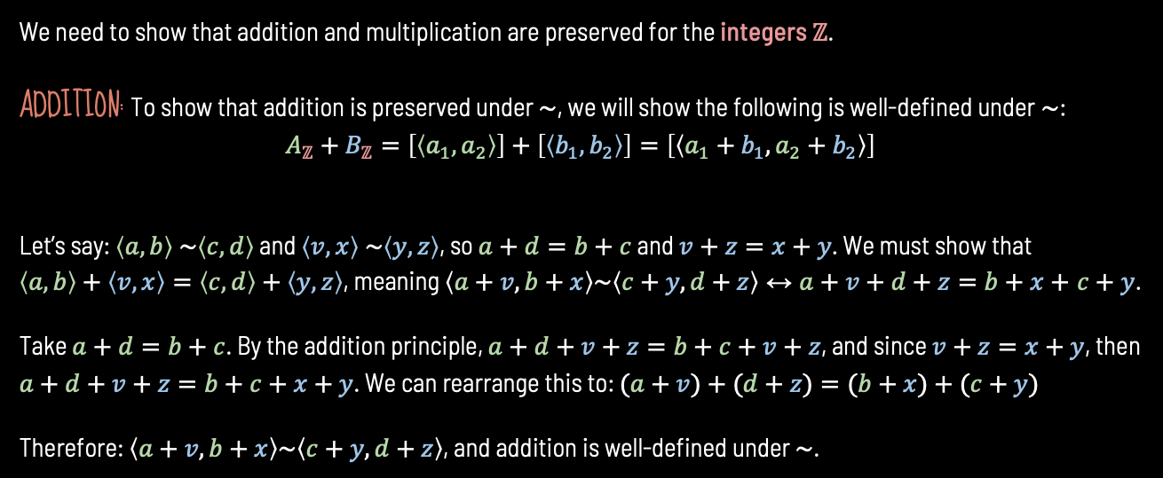
DEFINING ARITHMETIC OPPERATIONS FOR INTEGERS
We need to show that addition and multiplication are preserved for the integers $ℤ$.
ADDITION: To show that addition is preserved under $\sim$, we will show the following is well-defined under$\sim$:
$$A_{ℤ}+B_{ℤ}=\left[\left\langle a_{1},a_{2}\right\rangle \right]+\left[\left\langle b_{1},b_{2}\right\rangle \right]=\left[\left\langle a_{1}+b_{1},a_{2}+b_{2}\right\rangle \right]$$
Let’s say: $\left\langle a,b\right\rangle \sim \left\langle c,d\right\rangle$ and $\left\langle v,x\right\rangle \sim \left\langle y,z\right\rangle$, so $a+d=b+c$ and $v+z=x+y$. We must show that $\left\langle a,b\right\rangle +\left\langle v,x\right\rangle =\left\langle c,d\right\rangle +\left\langle y,z\right\rangle$, meaning $\left\langle a+v,b+x\right\rangle \sim \left\langle c+y,d+z\right\rangle ↔a+v+d+z=b+x+$ $c+y$.
Take $a+d=b+c$. By the addition principle, $a+d+v+z=b+c+v+z$, and since $v+z=x+y$, then $a+d+v+z=b+c+x+y$. We can rearrange this to: $(a+v)+(d+z)=(b+x)+(c+y)$
Therefore: $\left\langle a+v,b+x\right\rangle \sim \left\langle c+y,d+z\right\rangle$, and addition is well-defined under $\sim$.

Slide 10
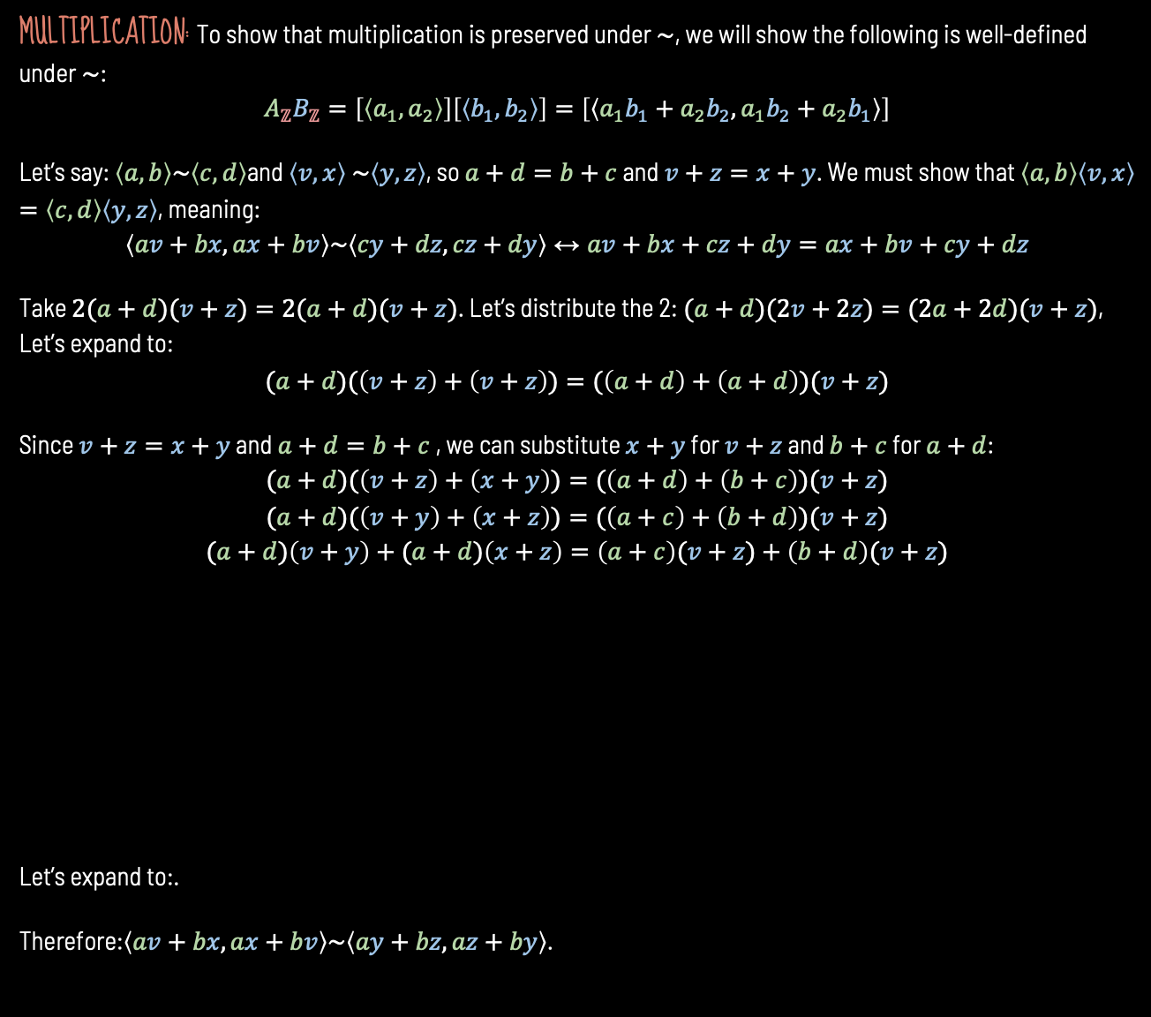
DEFINING ARITHMETIC OPPERATIONS FOR INTEGERS CONTINUED
MULTIPLICATION: To show that multiplication is preserved under $\sim$, we will show the following is well-defined under$\sim$:
$$A_{ℤ}B_{ℤ}=\left[\left\langle a_{1},a_{2}\right\rangle \right]\left[\left\langle b_{1},b_{2}\right\rangle \right]=\left[\left\langle a_{1}b_{1}+a_{2}b_{2},a_{1}b_{2}+a_{2}b_{1}\right\rangle \right]$$
Let’s say: $\left\langle a,b\right\rangle \sim \left\langle c,d\right\rangle$and $\left\langle v,x\right\rangle \sim \left\langle y,z\right\rangle$, so $a+d=b+c$ and $v+z=x+y$. We must show that $\left\langle a,b\right\rangle \left\langle v,x\right\rangle =\left\langle c,d\right\rangle \left\langle y,z\right\rangle$, meaning:
$$\left\langle av+bx,ax+bv\right\rangle \sim \left\langle cy+dz,cz+dy\right\rangle ↔av+bx+cz+dy=ax+bv+cy+dz$$
Take $2(a+d)(v+z)=2(a+d)(v+z)$. Let’s distribute the 2:$(a+d)(2v+2z)=(2a+2d)(v+z)$, Let’s expand to:
$$(a+d)(\left(v+z\right)+\left(v+z\right))=(\left(a+d\right)+\left(a+d\right))(v+z)$$
Since $v+z=x+y$ and $a+d=b+c$ , we can substitute $x+y$ for $v+z$ and $b+c$ for $a+d$:
$$(a+d)(\left(v+z\right)+\left(x+y\right))=(\left(a+d\right)+\left(b+c\right))(v+z)$$
$$(a+d)(\left(v+y\right)+\left(x+z\right))=(\left(a+c\right)+\left(b+d\right))(v+z)$$
$$(a+d)\left(v+y\right)+(a+d)\left(x+z\right)=\left(a+c\right)(v+z)+\left(b+d\right)(v+z)$$
Let’s expand to:.
Therefore:$\left\langle av+bx,ax+bv\right\rangle \sim \left\langle ay+bz,az+by\right\rangle$.

Slide 11
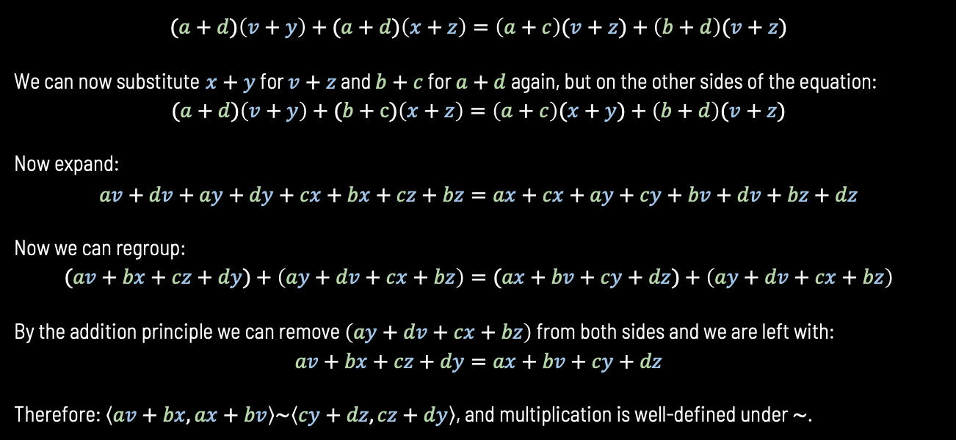
CONSTRUCTING MULTIPLICATION CONTINUED
$$(a+d)\left(v+y\right)+(a+d)\left(x+z\right)=\left(a+c\right)(v+z)+\left(b+d\right)(v+z)$$
We can now substitute $x+y$ for $v+z$ and $b+c$ for $a+d$ again, but on the other sides of the equation:
$$(a+d)\left(v+y\right)+(b+c)\left(x+z\right)=\left(a+c\right)(x+y)+\left(b+d\right)(v+z)$$
Now expand:
$$av+dv+ay+dy+cx+bx+cz+bz=ax+cx+ay+cy+bv+dv+bz+dz$$
Now we can regroup:
$$(av+bx+cz+dy)+\left(ay+dv+cx+bz\right)=(ax+bv+cy+dz)+\left(ay+dv+cx+bz\right)$$
By the addition principle we can remove $\left(ay+dv+cx+bz\right)$ from both sides and we are left with:
$$av+bx+cz+dy=ax+bv+cy+dz$$
Therefore: $\left\langle av+bx,ax+bv\right\rangle \sim \left\langle cy+dz,cz+dy\right\rangle$, and multiplication is well-defined under $\sim$.

Slide 12
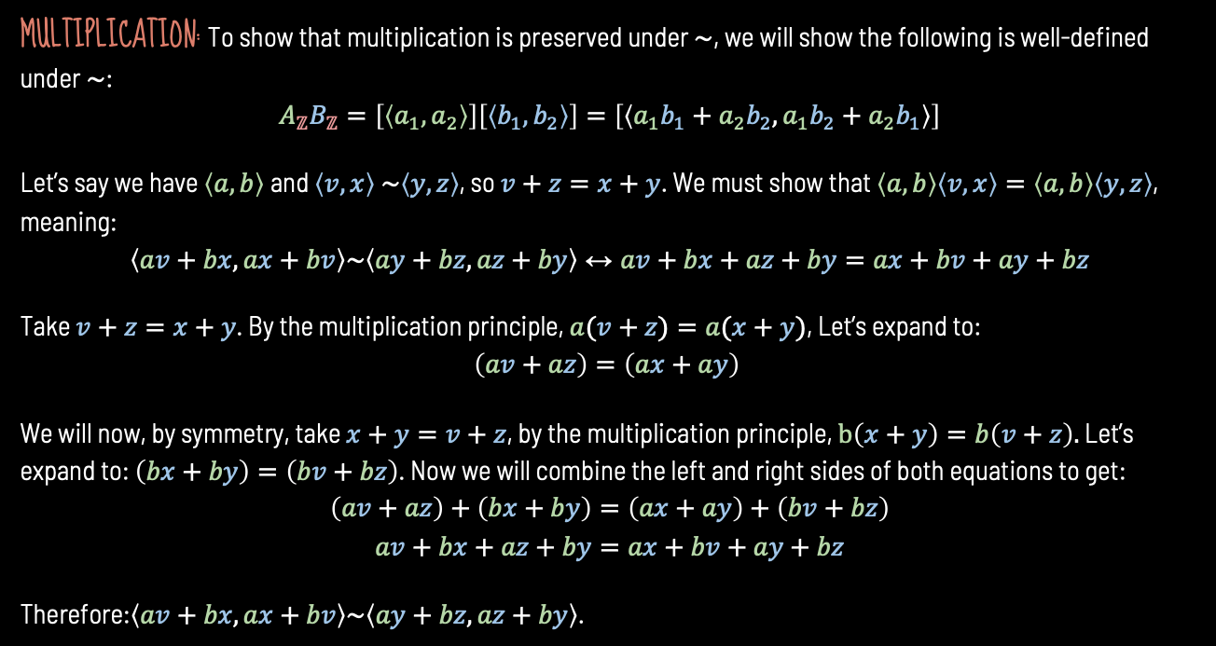
DEFINING ARITHMETIC OPPERATIONS FOR INTEGERS CONTINUED
MULTIPLICATION: To show that multiplication is preserved under $\sim$, we will show the following is well-defined under$\sim$:
$$A_{ℤ}B_{ℤ}=\left[\left\langle a_{1},a_{2}\right\rangle \right]\left[\left\langle b_{1},b_{2}\right\rangle \right]=\left[\left\langle a_{1}b_{1}+a_{2}b_{2},a_{1}b_{2}+a_{2}b_{1}\right\rangle \right]$$
Let’s say we have $\left\langle a,b\right\rangle$and $\left\langle v,x\right\rangle \sim \left\langle y,z\right\rangle$, so $v+z=x+y$. We must show that $\left\langle a,b\right\rangle \left\langle v,x\right\rangle =\left\langle a,b\right\rangle \left\langle y,z\right\rangle$, meaning:
$$\left\langle av+bx,ax+bv\right\rangle \sim \left\langle ay+bz,az+by\right\rangle ↔av+bx+az+by=ax+bv+ay+bz$$
Take $v+z=x+y$. By the multiplication principle, $a(v+z)=a(x+y)$, Let’s expand to:
$$\left(av+az\right)=\left(ax+ay\right)$$
We will now, by symmetry, take $x+y=v+z$, by the multiplication principle, $b\left(x+y\right)=b\left(v+z\right).$ Let’s expand to: $\left(bx+by\right)=\left(bv+bz\right)$. Now we will combine the left and right sides of both equations to get:
$$\left(av+az\right)+\left(bx+by\right)=\left(ax+ay\right)+\left(bv+bz\right)$$
$$av+bx+az+by=ax+bv+ay+bz$$
Therefore:$\left\langle av+bx,ax+bv\right\rangle \sim \left\langle ay+bz,az+by\right\rangle$.

Slide 13








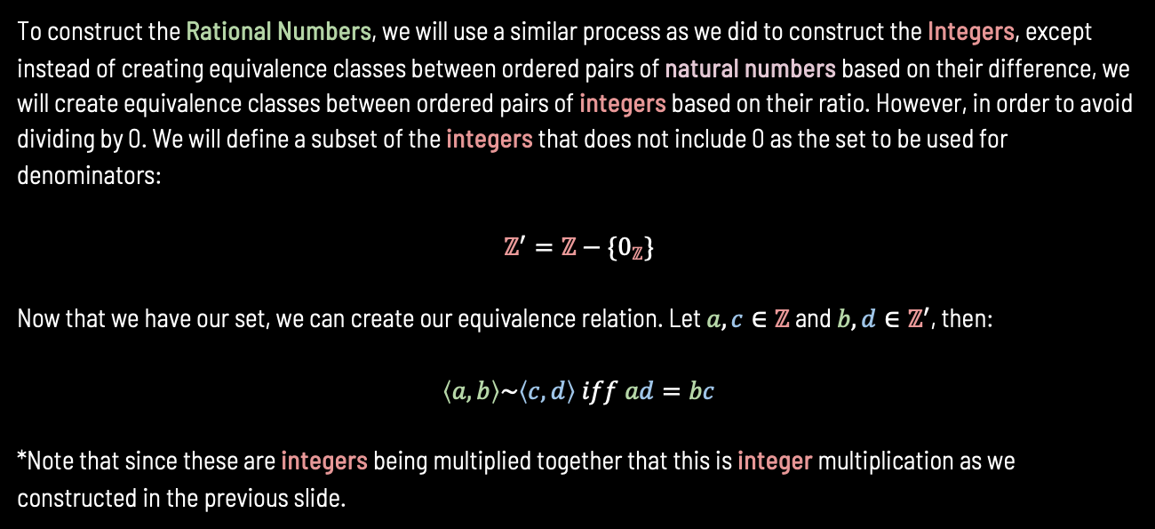






CONSTRUCTING THE RATIONAL NUMBERS
To construct the Rational Numbers, we will use a similar process as we did to construct the Integers, except instead of creating equivalence classes between ordered pairs of natural numbers based on their difference, we will create equivalence classes between ordered pairs of integers based on their ratio. However, in order to avoid dividing by 0. We will define a subset of the integers that does not include 0 as the set to be used for denominators:
$$ℤ^{′}=ℤ−\{0_{ℤ}\}$$
Now that we have our set, we can create our equivalence relation. Let $a,c∈ℤ$ and $b,d∈ℤ^{′}$, then:
$$\left\langle a,b\right\rangle \sim \left\langle c,d\right\rangle iff ad=bc$$
*Note that since these are integers being multiplied together that this is integer multiplication as we constructed in the previous slide.
$$(−1/5)$$
($−13/65)$
$$−1/5=$$
$$(1/−5)$$
$$\left\langle 4,−20\right\rangle$$
$$(3/−15)$$
…
$$(−9/45)$$
$$1=$$
$$\left\langle 1,1\right\rangle$$
$$\left\langle 7,7\right\rangle$$
$$\left\langle −1,−1\right\rangle$$
$$\left\langle −13,−13\right\rangle$$
$$\left\langle 2,2\right\rangle$$
$$\left\langle 8,8\right\rangle$$

Slide 14
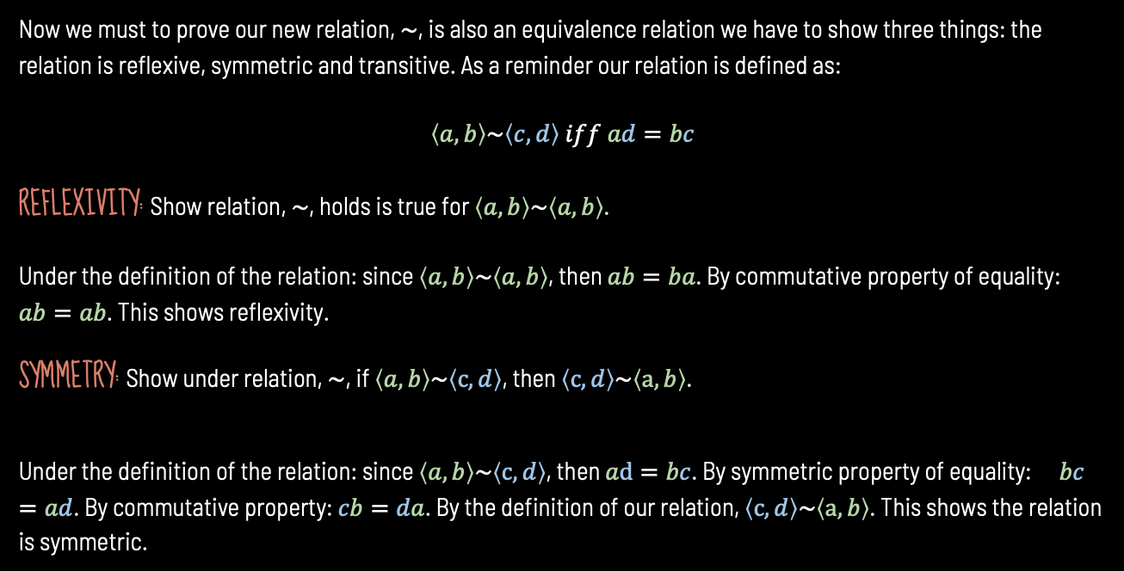
PROVING EQUIVALENCE RELATION Pt.2
Now we must to prove our new relation, $\sim$, is also an equivalence relation we have to show three things: the relation is reflexive, symmetric and transitive. As a reminder our relation is defined as:
$$\left\langle a,b\right\rangle \sim \left\langle c,d\right\rangle iff ad=bc$$
REFLEXIVITY: Show relation, $\sim$, holds is true for $\left\langle a,b\right\rangle \sim \left\langle a,b\right\rangle$.
Under the definition of the relation: since $\left\langle a,b\right\rangle \sim \left\langle a,b\right\rangle$, then $ab=ba$. By commutative property of equality:
$ab=ab$. This shows reflexivity.
SYMMETRY: Show under relation, $\sim$, if $\left\langle a,b\right\rangle \sim \left\langle c,d\right\rangle$, then $\left\langle c,d\right\rangle \sim \left\langle a,b\right\rangle$.
Under the definition of the relation: since $\left\langle a,b\right\rangle \sim \left\langle c,d\right\rangle$, then $ad=bc$. By symmetric property of equality: $bc=ad$. By commutative property: $cb=da$. By the definition of our relation, $\left\langle c,d\right\rangle \sim \left\langle a,b\right\rangle$. This shows the relation is symmetric.

Slide 15
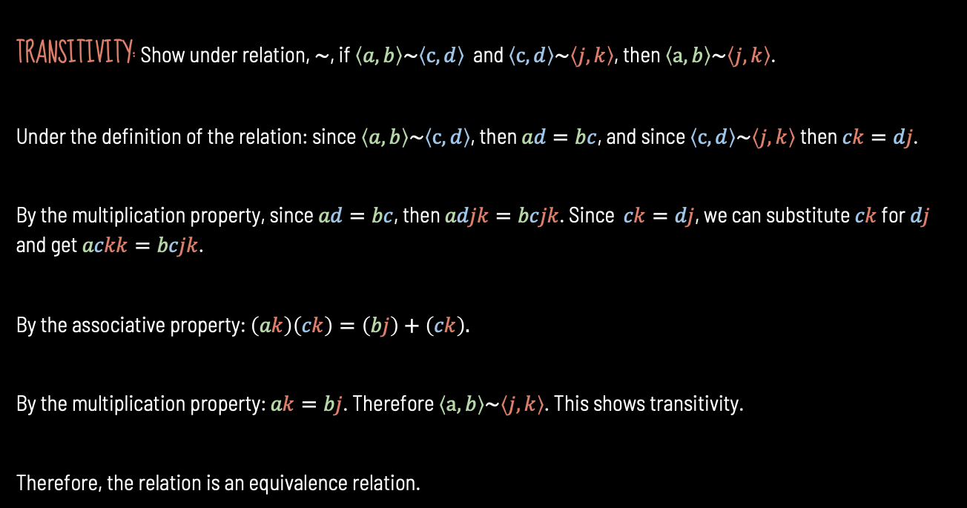
PROVING EQUIVALENCE RELATION Pt.2 CONTINUED
TRANSITIVITY: Show under relation, $\sim$, if $\left\langle a,b\right\rangle \sim \left\langle c,d\right\rangle$ and $\left\langle c,d\right\rangle \sim \left\langle j,k\right\rangle$, then $\left\langle a,b\right\rangle \sim \left\langle j,k\right\rangle$.
Under the definition of the relation: since $\left\langle a,b\right\rangle \sim \left\langle c,d\right\rangle$, then $ad=bc$, and since $\left\langle c,d\right\rangle \sim \left\langle j,k\right\rangle$ then $ck=dj$.
By the multiplication property, since $ad=bc$, then $adjk=bcjk$. Since $ck=dj$, we can substitute $ck$ for $dj$ and get $ackk=bcjk$.
By the associative property: $\left(ak\right)\left(ck\right)=\left(bj\right)+\left(ck\right).$
By the multiplication property: $ak=bj$. Therefore $\left\langle a,b\right\rangle \sim \left\langle j,k\right\rangle$. This shows transitivity.
Therefore, the relation is an equivalence relation.

Slide 16




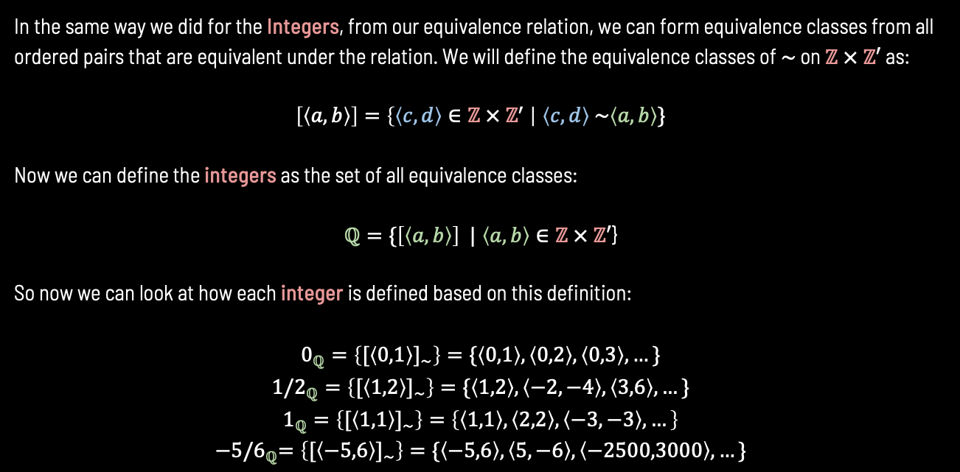





DEFINING THE RATIONAL NUMBERS.
In the same way we did for the Integers, from our equivalence relation, we can form equivalence classes from all ordered pairs that are equivalent under the relation. We will define the equivalence classes of $\sim$ on $ℤ × ℤ′$ as:
$\left[\left\langle a,b\right\rangle \right]=\left\{\left\langle c,d\right\rangle ∈ℤ × ℤ^{′} \right|$ $\left\langle c,d\right\rangle \sim \left\langle a,b\right\rangle \}$
Now we can define the integers as the set of all equivalence classes:
$ℚ=\{\left[\left\langle a,b\right\rangle \right] |$ $\left\langle a,b\right\rangle ∈ℤ × ℤ′$}
So now we can look at how each integer is defined based on this definition:
$$0_{ℚ}=\left\{{[\left\langle 0,1\right\rangle ]}_{\sim }\right\}=\{\left\langle 0,1\right\rangle ,\left\langle 0,2\right\rangle ,\left\langle 0,3\right\rangle ,…\}$$
$${1/2}_{ℚ}=\left\{{[\left\langle 1,2\right\rangle ]}_{\sim }\right\}=\{\left\langle 1,2\right\rangle ,\left\langle −2,−4\right\rangle ,\left\langle 3,6\right\rangle ,…\}$$
$$1_{ℚ}=\left\{{[\left\langle 1,1\right\rangle ]}_{\sim }\right\}=\left\{\left\langle 1,1\right\rangle ,\left\langle 2,2\right\rangle ,\left\langle −3,−3\right\rangle ,…\right\}$$
$${−5/6}_{ℚ}=\left\{{[\left\langle −5,6\right\rangle ]}_{\sim }\right\}=\{\left\langle −5,6\right\rangle ,\left\langle 5,−6\right\rangle ,\left\langle −2500,3000\right\rangle ,…\}$$
$$a$$
$$5$$
$$4$$
$$3$$
$$2$$
$$1$$
$$b$$
$$−1$$
$$−2$$
$$−3$$
$$−4$$
$$1$$
$$2$$
$$3$$
$$4$$
$$5$$

Slide 17
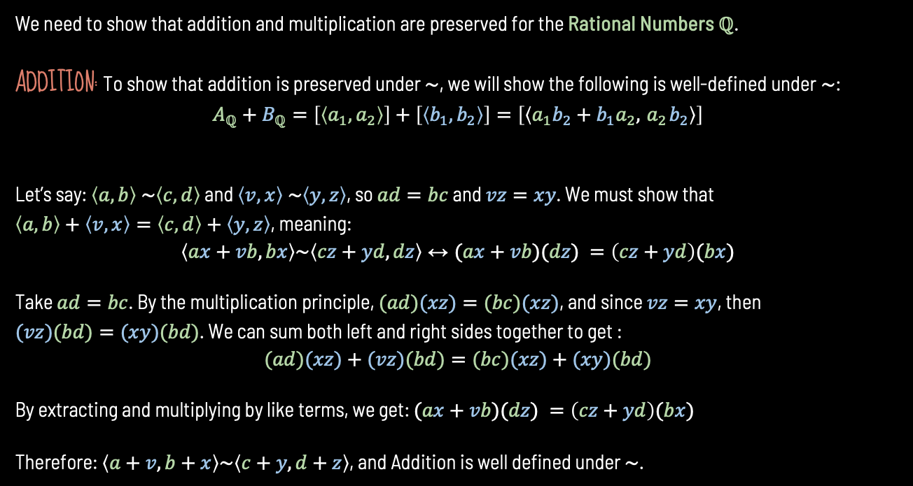
DEFINING ARITHMETIC OPPERATIONS FOR RATIONAL NUMBERS
We need to show that addition and multiplication are preserved for the Rational Numbers $ℚ$.
ADDITION: To show that addition is preserved under $\sim$, we will show the following is well-defined under$\sim$:
$$A_{ℚ}+B_{ℚ}=\left[\left\langle a_{1},a_{2}\right\rangle \right]+\left[\left\langle b_{1},b_{2}\right\rangle \right]=\left[\left\langle a_{1}b_{2}+b_{1}a_{2}, { a}_{2}b_{2}\right\rangle \right]$$
Let’s say: $\left\langle a,b\right\rangle \sim \left\langle c,d\right\rangle$ and $\left\langle v,x\right\rangle \sim \left\langle y,z\right\rangle$, so $ad=bc$ and $vz=xy$. We must show that $\left\langle a,b\right\rangle +\left\langle v,x\right\rangle =\left\langle c,d\right\rangle +\left\langle y,z\right\rangle$, meaning:
$$\left\langle ax+vb,bx\right\rangle \sim \left\langle cz+yd,dz\right\rangle ↔(ax+vb)(dz) =\left(cz+yd\right)(bx)$$
Take $ad=bc$. By the multiplication principle, $(ad)(xz)=(bc)(xz)$, and since $vz=xy$, then $(vz)(bd)=(xy)(bd)$. We can sum both left and right sides together to get :
$$(ad)(xz)+(vz)(bd)=(bc)(xz)+(xy)(bd)$$
By extracting and multiplying by like terms, we get: $(ax+vb)(dz) =\left(cz+yd\right)(bx)$
Therefore: $\left\langle a+v,b+x\right\rangle \sim \left\langle c+y,d+z\right\rangle$, and Addition is well defined under $\sim$.

Slide 18
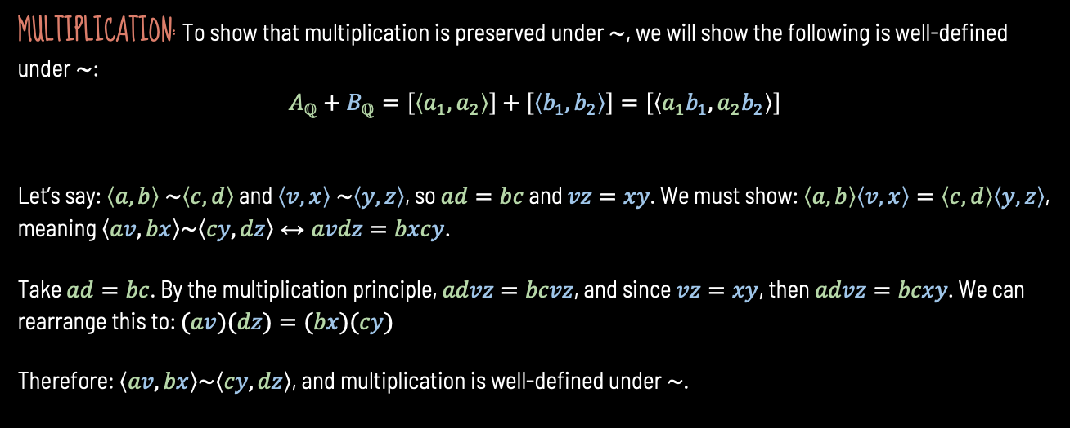
DEFINING ARITHMETIC OPPERATIONS FOR RATIONAL NUMBERS Cont.
MULTIPLICATION: To show that multiplication is preserved under $\sim$, we will show the following is well-defined under$\sim$:
$$A_{ℚ}+B_{ℚ}=\left[\left\langle a_{1},a_{2}\right\rangle \right]+\left[\left\langle b_{1},b_{2}\right\rangle \right]=\left[\left\langle a_{1}b_{1},a_{2}b_{2}\right\rangle \right]$$
Let’s say: $\left\langle a,b\right\rangle \sim \left\langle c,d\right\rangle$ and $\left\langle v,x\right\rangle \sim \left\langle y,z\right\rangle$, so $ad=bc$ and $vz=xy$. We must show: $\left\langle a,b\right\rangle \left\langle v,x\right\rangle =\left\langle c,d\right\rangle \left\langle y,z\right\rangle$, meaning $\left\langle av,bx\right\rangle \sim \left\langle cy,dz\right\rangle ↔avdz=bxcy$.
Take $ad=bc$. By the multiplication principle, $advz=bcvz$, and since $vz=xy$, then $advz=bcxy$. We can rearrange this to: $(av)(dz)=(bx)(cy)$
Therefore: $\left\langle av,bx\right\rangle \sim \left\langle cy,dz\right\rangle$, and multiplication is well-defined under $\sim$.

Slide 19
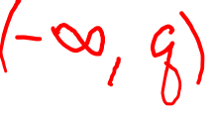
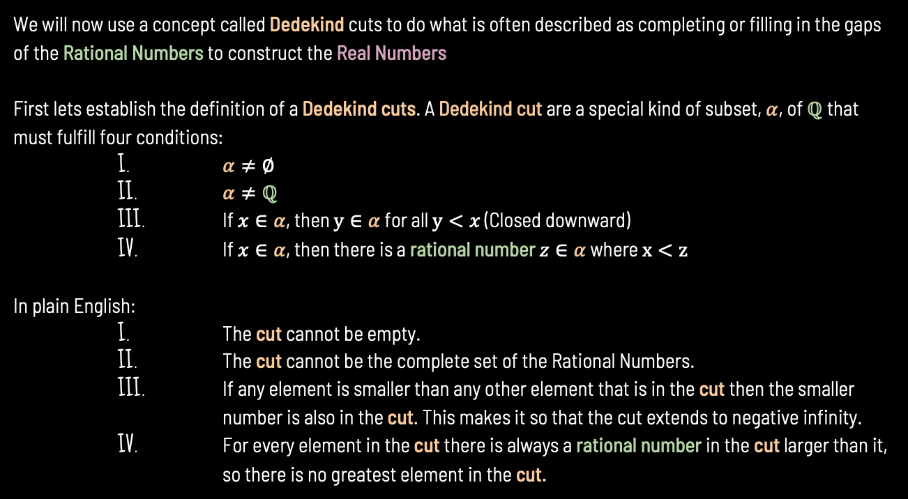
CONSTRUCTING THE REAL NUMBERS USING DEDEKIND CUTS
We will now use a concept called Dedekind cuts to do what is often described as completing or filling in the gaps of the Rational Numbers to construct the Real Numbers
First lets establish the definition of a Dedekind cuts. A Dedekind cut are a special kind of subset, $α$, of $ℚ$that must fulfill four conditions:
I. $α≠∅$
II. $α≠ℚ$
III. If $x∈α$, then $y∈α$ for all $y<x$ (Closed downward)
IV. If $x∈α$, then there is a rational number $z∈α$ where $x<z$
In plain English:
I. The cut cannot be empty.
II. The cut cannot be the complete set of the Rational Numbers.
III. If any element is smaller than any other element that is in the cut then the smaller number is also in the cut. This makes it so that the cut extends to negative infinity.
IV. For every element in the cut there is always a rational number in the cut larger than it, so there is no greatest element in the cut.

Slide 20


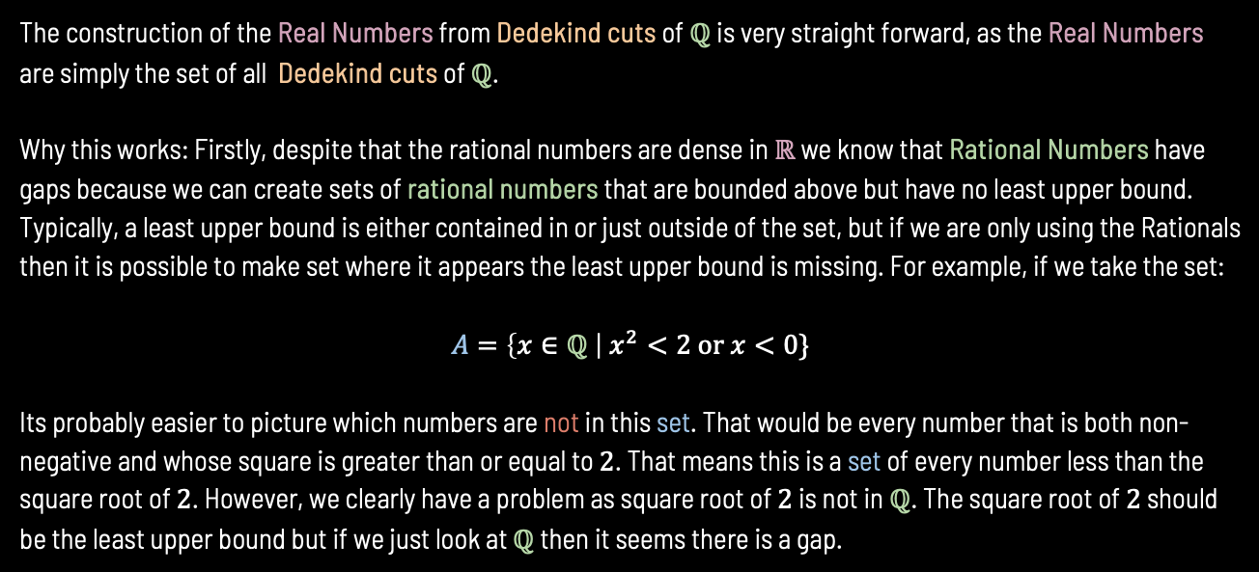

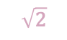

CONSTRUCTING THE REAL NUMBERS USING DEDEKIND CUTS Cont.
The construction of the Real Numbers from Dedekind cuts of $ℚ$ is very straight forward, as the Real Numbers are simply the set of all Dedekind cuts of $ℚ$.
Why this works: Firstly, despite that the rational numbers are dense in $ℝ$ we know that Rational Numbers have gaps because we can create sets of rational numbers that are bounded above but have no least upper bound. Typically, a least upper bound is either contained in or just outside of the set, but if we are only using the Rationals then it is possible to make set where it appears the least upper bound is missing. For example, if we take the set:
$$A=\left\{x∈ℚ \right| x^{2}<2 or x<0\}$$
Its probably easier to picture which numbers are not in this set. That would be every number that is both non-negative and whose square is greater than or equal to $2$. That means this is a set of every number less than the square root of $2$. However, we clearly have a problem as square root of $2$ is not in $ℚ$. The square root of $2$ should be the least upper bound but if we just look at $ℚ$ then it seems there is a gap.
$$\sqrt{2}$$
$$0$$
$$1$$
$$2$$
$$−∞$$
$$∞$$

Slide 21
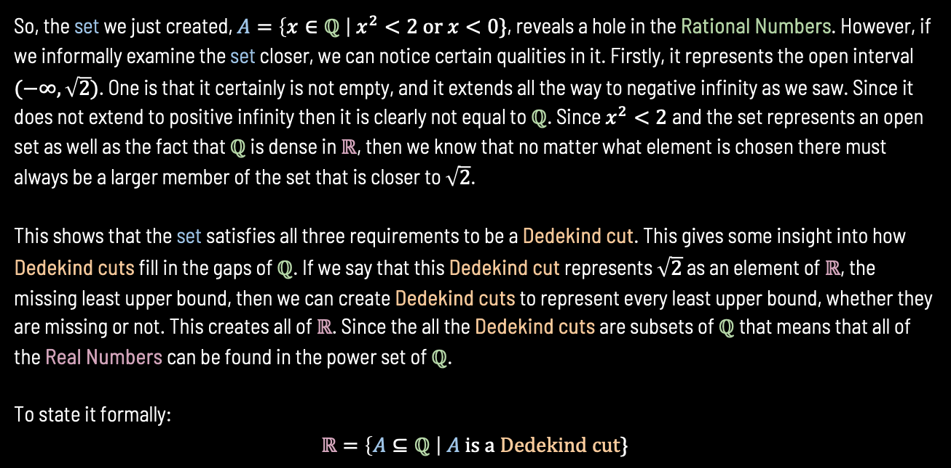
CONSTRUCTING THE REAL NUMBERS USING DEDEKIND CUTS Cont. 2
So, the set we just created, $A=\left\{x∈ℚ \right| x^{2}<2 or x<0\}$, reveals a hole in the Rational Numbers. However, if we informally examine the set closer, we can notice certain qualities in it. Firstly, it represents the open interval $(−∞,\sqrt{2})$. One is that it certainly is not empty, and it extends all the way to negative infinity as we saw. Since it does not extend to positive infinity then it is clearly not equal to $ℚ$. Since $x^{2}<2$and the set represents an open set as well as the fact that $ℚ$ is dense in $ℝ$, then we know that no matter what element is chosen there must always be a larger member of the set that is closer to $\sqrt{2}$.
This shows that the set satisfies all three requirements to be a Dedekind cut. This gives some insight into how Dedekind cuts fill in the gaps of $ℚ$. If we say that this Dedekind cut represents $\sqrt{2}$ as an element of $ℝ$, the missing least upper bound, then we can create Dedekind cuts to represent every least upper bound, whether they are missing or not. This creates all of $ℝ$. Since the all the Dedekind cuts are subsets of $ℚ$ that means that all of the Real Numbers can be found in the power set of $ℚ$.
To state it formally:
$$ℝ=\left\{A⊆ℚ \right| A is a Dedekind cut\}$$

Slide 22
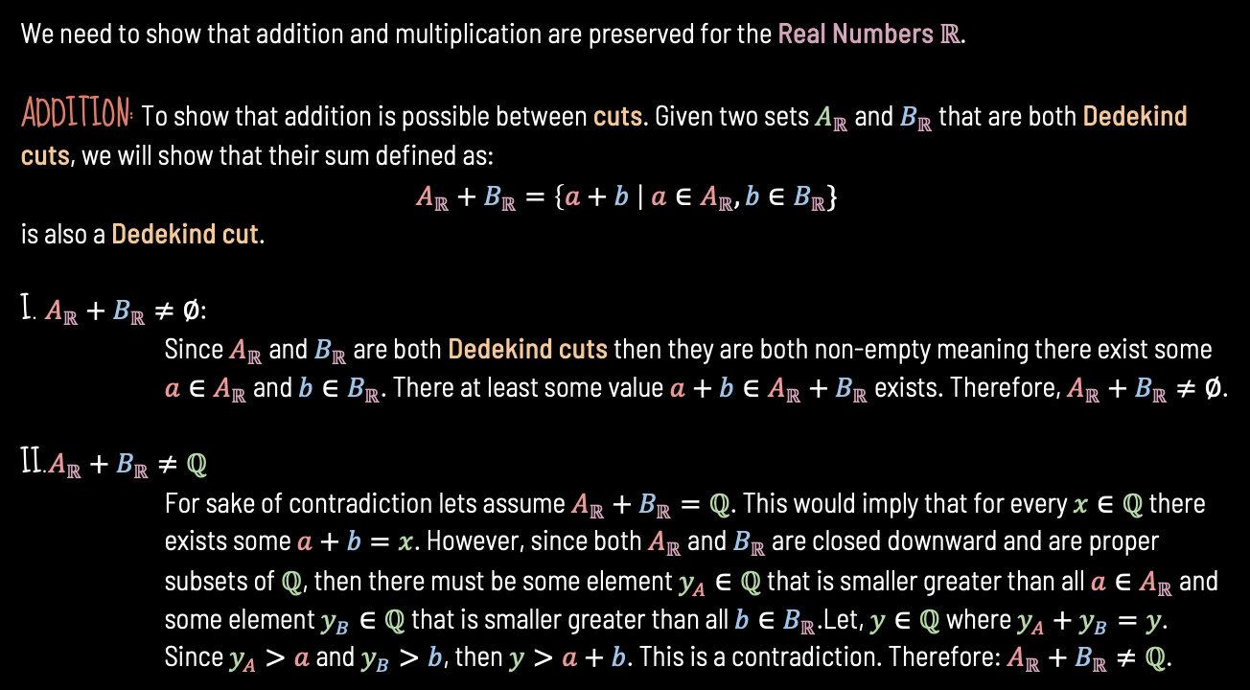
DEFINING ARITHMETIC OPPERATIONS FOR REAL NUMBERS
We need to show that addition and multiplication are preserved for the Real Numbers $ℝ$.
ADDITION: To show that addition is possible between cuts. Given two sets $A_{ℝ}$ and $B_{ℝ}$ that are both Dedekind cuts, we will show that their sum defined as:
$$A_{ℝ}+B_{ℝ}=\left\{a+b \right| a∈A_{ℝ},b∈B_{ℝ}\}$$
is also a Dedekind cut.
I. $A_{ℝ}+B_{ℝ}≠∅$:
Since $A_{ℝ}$ and $B_{ℝ}$ are both Dedekind cuts then they are both non-empty meaning there exist some $a∈A_{ℝ}$ and $b∈B_{ℝ}$. There at least some value $a+b∈A_{ℝ}+B_{ℝ}$ exists. Therefore, $A_{ℝ}+B_{ℝ}≠∅$.
II.$A_{ℝ}+B_{ℝ}≠ℚ$
For sake of contradiction lets assume $A_{ℝ}+B_{ℝ}=ℚ$. This would imply that for every $x∈ℚ$ there exists some $a+b=x$. However, since both $A_{ℝ}$ and $B_{ℝ}$ are closed downward and are proper subsets of $ℚ$, then there must be some element $y_{A}∈ℚ$ that is smaller greater than all $a∈A_{ℝ}$ and some element $y_{B}∈ℚ$ that is smaller greater than all $b∈B_{ℝ}$.Let, $y∈ℚ$ where $y_{A}+y_{B}=y$. Since $y_{A}>a$ and $y_{B}>b$, then $y>a+b$. This is a contradiction. Therefore: $A_{ℝ}+B_{ℝ}≠ℚ$.

Slide 23
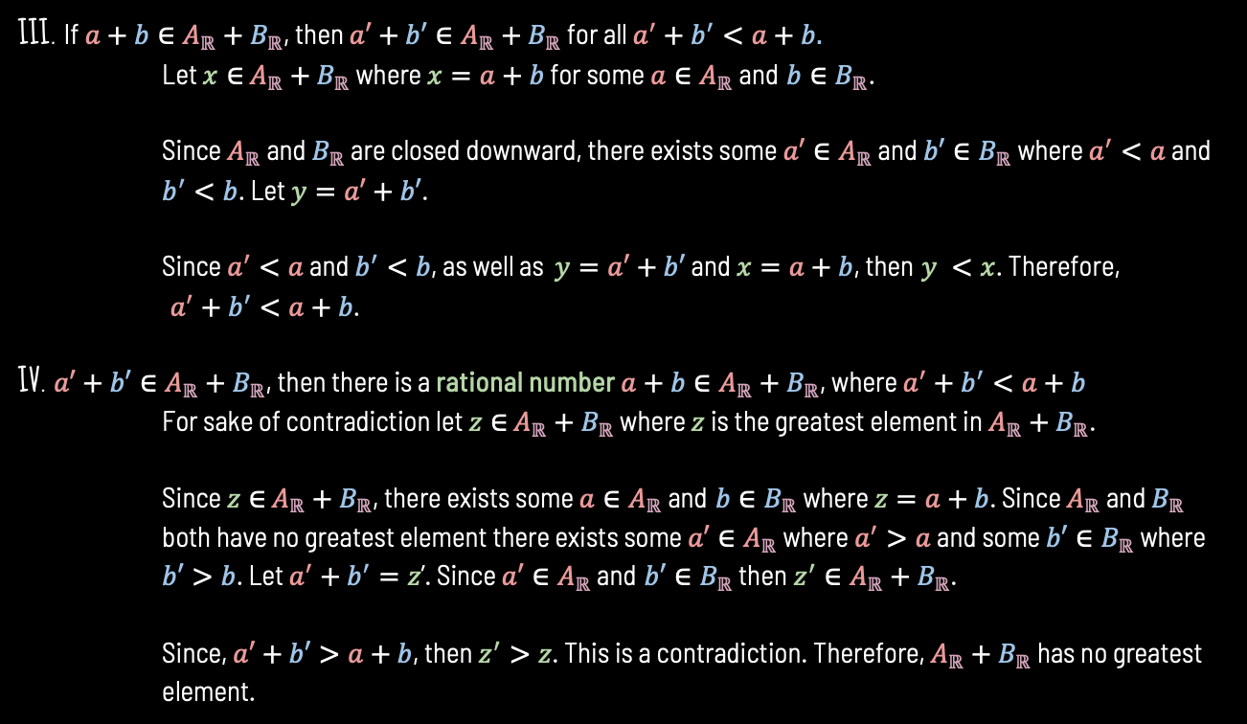
DEFINING ADDITION OPPERATIONS FOR REAL NUMBERS CONTINUED
III. If $a+b∈A_{ℝ}+B_{ℝ}$, then $a′+b′∈A_{ℝ}+B_{ℝ}$ for all $a^{′}+b^{′}<a+b.$
Let $x∈$ $A_{ℝ}+B_{ℝ}$ where $x=a+b$ for some $a∈A_{ℝ}$ and $b∈B_{ℝ}$.
Since $A_{ℝ}$ and $B_{ℝ}$ are closed downward, there exists some $a′∈A_{ℝ}$ and $b′∈B_{ℝ}$ where $a^{′}<a$ and $b^{′}<b$. Let $y=a′+b′$.
Since $a^{′}<a$ and $b^{′}<b$, as well as $y=a′+b′$ and $x=a+b$, then $y <x$. Therefore,
$a^{′}+b^{′}<a+b$.
IV. $a′+b′∈A_{ℝ}+B_{ℝ}$, then there is a rational number $a+b∈A_{ℝ}+B_{ℝ}$, where $a^{′}+b^{′}<a+b$
For sake of contradiction let $z∈$ $A_{ℝ}+B_{ℝ}$ where $z$ is the greatest element in $A_{ℝ}+B_{ℝ}$.
Since $z∈$ $A_{ℝ}+B_{ℝ}$, there exists some $a∈A_{ℝ}$ and $b∈B_{ℝ}$ where $z=a+b$. Since $A_{ℝ}$ and $B_{ℝ}$ both have no greatest element there exists some $a′∈A_{ℝ}$ where $a^{′}>a$ and some $b′∈B_{ℝ}$ where $b′>b$. Let $a^{′}+b^{′}=z$’. Since $a′∈A_{ℝ}$ and $b′∈B_{ℝ}$ then$z^{′}∈A_{ℝ}+B_{ℝ}$.
Since, $a′+b′>a+b$, then $z^{′}>z$. This is a contradiction. Therefore, $A_{ℝ}+B_{ℝ}$ has no greatest element.

Slide 24
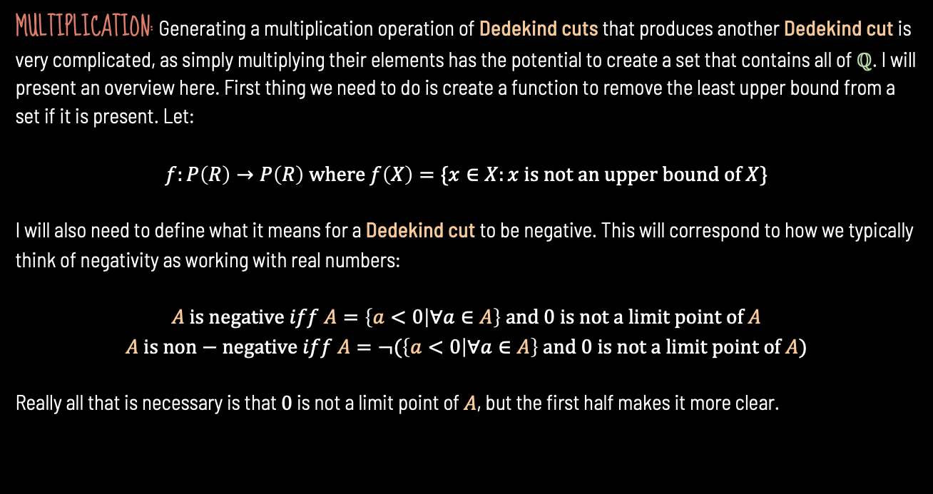
DEFINING MULTIPLICATION OPPERATIONS FOR REAL NUMBERS
MULTIPLICATION: Generating a multiplication operation of Dedekind cuts that produces another Dedekind cut is very complicated, as simply multiplying their elements has the potential to create a set that contains all of $ℚ$. I will present an overview here. First thing we need to do is create a function to remove the least upper bound from a set if it is present. Let:
$$f:P\left(R\right)→P\left(R\right) where f\left(X\right)=\{x∈X:x is not an upper bound of X\}$$
I will also need to define what it means for a Dedekind cut to be negative. This will correspond to how we typically think of negativity as working with real numbers:
$$A is negative iff A=\left\{a<0 | ∀a∈A\right\} and 0 is not a limit point of A$$
$$A is non−negative iff A=¬(\left\{a<0 | ∀a∈A\right\} and 0 is not a limit point of A)$$
Really all that is necessary is that $0$ is not a limit point of $A$, but the first half makes it more clear.

Slide 25
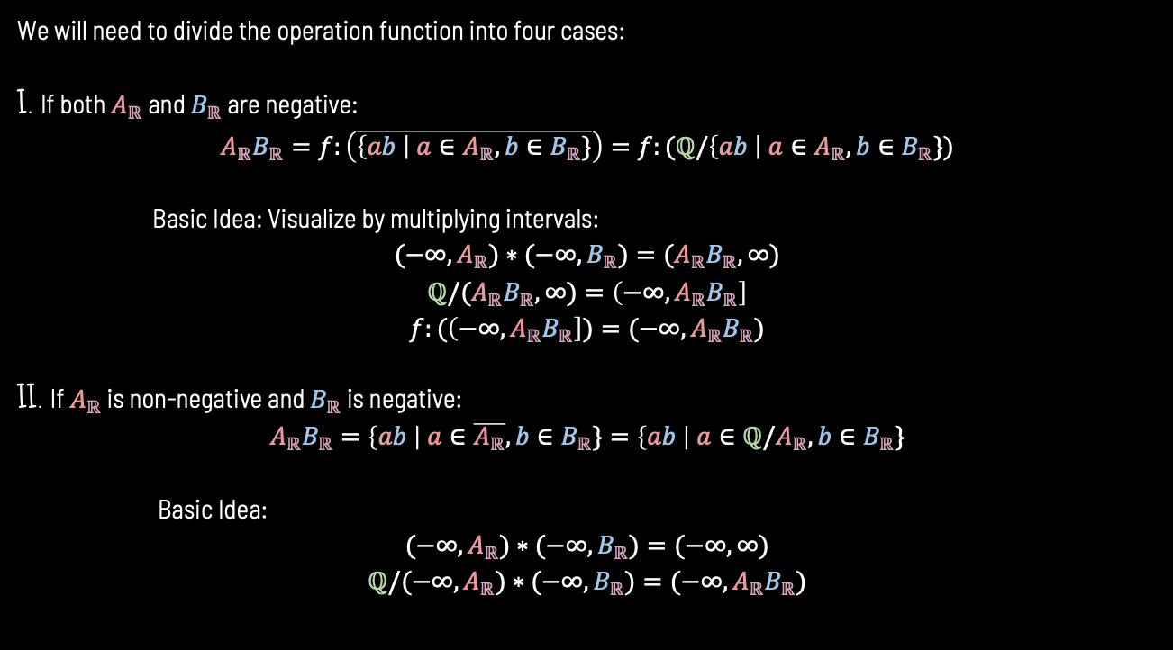
DEFINING MULTIPLICATION OPPERATIONS FOR REAL NUMBERS Cont.
We will need to divide the operation function into four cases:
I. If both $A_{ℝ}$ and $B_{ℝ}$ are negative:
$$A_{ℝ}B_{ℝ}=f:\left(\overline{\left\{ab \right| a∈A_{ℝ},b∈B_{ℝ}\}}\right)=f:(ℚ/\left\{ab \right| a∈A_{ℝ},b∈B_{ℝ}\})$$
Basic Idea: Visualize by multiplying intervals:
$$(−∞,A_{ℝ})∗(−∞,B_{ℝ})=(A_{ℝ}B_{ℝ},∞)$$
$$ℚ/(A_{ℝ}B_{ℝ},∞)=\left(−∞,A_{ℝ}B_{ℝ}\right]$$
$$f:(\left(−∞,A_{ℝ}B_{ℝ}\right])=(−∞,A_{ℝ}B_{ℝ})$$
II. If $A_{ℝ}$ is non-negative and $B_{ℝ}$ is negative:
$$A_{ℝ}B_{ℝ}=\left\{ab \right| a∈\overline{A_{ℝ}},b∈B_{ℝ}\}=\left\{ab \right| a∈ℚ/A_{ℝ},b∈B_{ℝ}\}$$
Basic Idea:
$$(−∞,A_{ℝ})∗(−∞,B_{ℝ})=(−∞,∞)$$
$$ℚ/(−∞,A_{ℝ})∗(−∞,B_{ℝ})=(−∞,A_{ℝ}B_{ℝ})$$

Slide 26
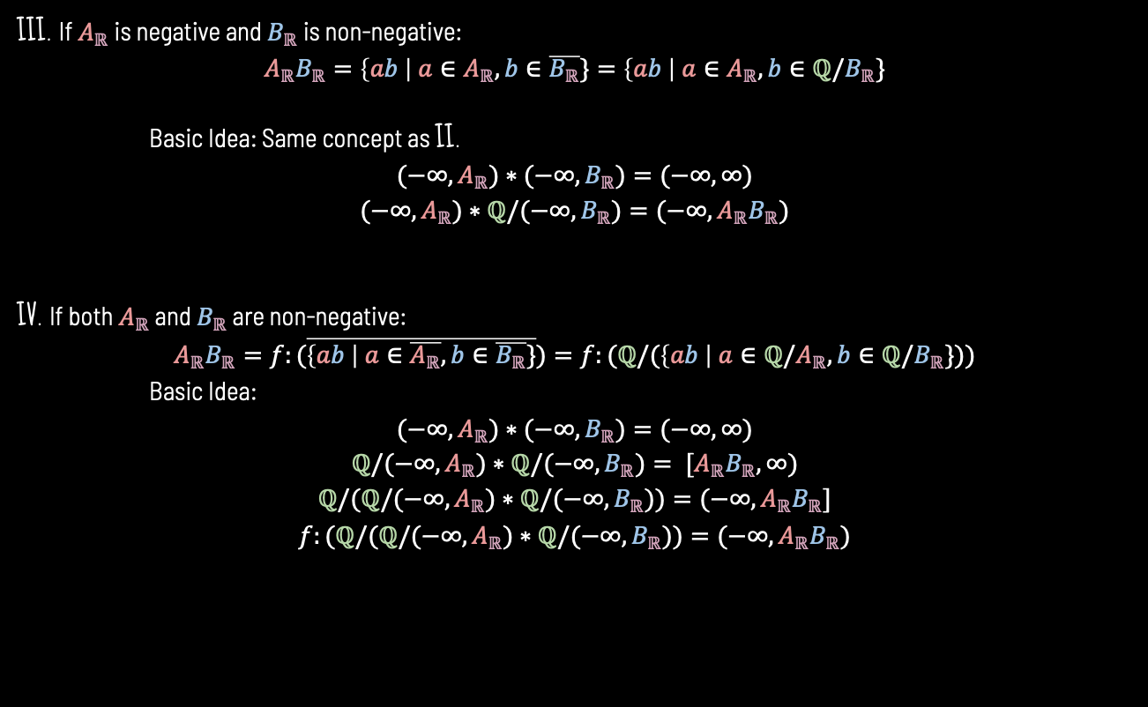
DEFINING MULTIPLICATION OPPERATIONS FOR REAL NUMBERS Cont.
III. If $A_{ℝ}$ is negative and $B_{ℝ}$ is non-negative:
$$A_{ℝ}B_{ℝ}=\left\{ab \right| a∈A_{ℝ},b∈\overline{B_{ℝ}}\}=\left\{ab \right| a∈A_{ℝ},b∈{ℚ/B}_{ℝ}\}$$
Basic Idea: Same concept as II.
$$(−∞,A_{ℝ})∗(−∞,B_{ℝ})=(−∞,∞)$$
$$(−∞,A_{ℝ})∗ℚ/(−∞,B_{ℝ})=(−∞,A_{ℝ}B_{ℝ})$$
IV. If both $A_{ℝ}$ and $B_{ℝ}$ are non-negative:
$$A_{ℝ}B_{ℝ}=f:(\overline{\left\{ab \right| a∈\overline{A_{ℝ}},b∈\overline{B_{ℝ}}\}})=f:(ℚ/(\left\{ab \right| a∈ℚ/A_{ℝ},b∈ℚ/B_{ℝ}\}))$$
Basic Idea:
$$(−∞,A_{ℝ})∗(−∞,B_{ℝ})=(−∞,∞)$$
$$ℚ/(−∞,A_{ℝ})∗ℚ/(−∞,B_{ℝ})= [A_{ℝ}B_{ℝ},∞)$$
$$ℚ/(ℚ/(−∞,A_{ℝ})∗ℚ/(−∞,B_{ℝ}))=(−∞,A_{ℝ}B_{ℝ}]$$
$$f:(ℚ/(ℚ/(−∞,A_{ℝ})∗ℚ/(−∞,B_{ℝ}))=(−∞,A_{ℝ}B_{ℝ})$$

Slide 27
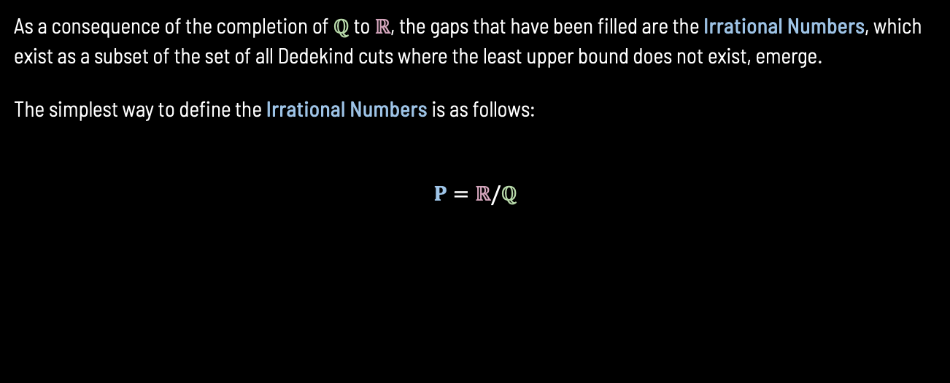
EMERGENCE OF IRRATIONAL NUMBERS
As a consequence of the completion of $ℚ$ to $ℝ$, the gaps that have been filled are the Irrational Numbers, which exist as a subset of the set of all Dedekind cuts where the least upper bound does not exist, emerge.
The simplest way to define the Irrational Numbers is as follows:
$$Ρ=ℝ/ℚ$$

Slide 28
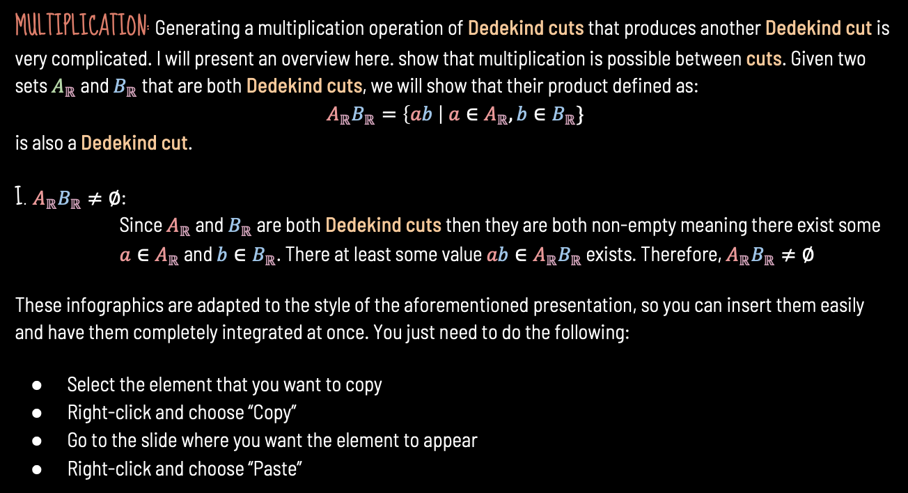
DEFINING MULTIPLICATION OPPERATIONS FOR REAL NUMBERS
MULTIPLICATION: Generating a multiplication operation of Dedekind cuts that produces another Dedekind cut is very complicated. I will present an overview here. show that multiplication is possible between cuts. Given two sets $A_{ℝ}$ and $B_{ℝ}$ that are both Dedekind cuts, we will show that their product defined as:
$$A_{ℝ}B_{ℝ}=\left\{ab \right| a∈A_{ℝ},b∈B_{ℝ}\}$$
is also a Dedekind cut.
I. $A_{ℝ}B_{ℝ}≠∅$:
Since $A_{ℝ}$ and $B_{ℝ}$ are both Dedekind cuts then they are both non-empty meaning there exist some $a∈A_{ℝ}$ and $b∈B_{ℝ}$. There at least some value $ab∈A_{ℝ}B_{ℝ}$ exists. Therefore, $A_{ℝ}B_{ℝ}≠∅$
These infographics are adapted to the style of the aforementioned presentation, so you can insert them easily and have them completely integrated at once. You just need to do the following:
Select the element that you want to copy
Right-click and choose “Copy”
Go to the slide where you want the element to appear
Right-click and choose “Paste”

Slide 29
Thanks for the Great Semester

